Slide 1
3D Image Segmentation and Quantification of Lysosome

Slide 2
INTRODUCCION
This project will aims to process and analyze 3D images to segment biological structures, specifically membrane and components(pancta).
The objective is to develop a pipeline that quantifies spatial relationships between these elements, for example calculating the percentage of panctas area within membranes or the amount of panctas in the membrane.
New objectives will be added to the research later.

Slide 3
Research STAGES
Preprocess and prepare 3D images for analysis.
Segment membranes and lysosome-like structures in 3D.
Quantify volumes and spatial relationships.
Generate statistical summaries per sample.
Produce visual overlays and plots for clear communication.

Slide 4
Dataset Description
3D .czi image stacks from microscopy.
High-resolution, multi-slice datasets.
Structures include membrane regions and lysosome-like objects.

Slide 5
Workflow Diagram
IMAGE PREPARATION
SEGMENTATION
SPATIAL QUANTIFICATION
STATISTICAL ANALYSIS

Slide 6
IMAGE PREPARATION
Data Preparation
- Input: 3D .CIZ images.
Preprocessing:
- Convert .ttif to a standard 3D format if needed (e.g., .tiff, .nii, .npy).
- Normalize intensity and remove noise using 3D Gaussian or median filtering.
- Slice visualization to inspect Z-stack quality and signal distribution.

Slide 7
SEGMENTATION
Membrane segmentation:
-Use 3D edge detection or thresholding (e.g., Otsu) on membrane-rich channels.
-Morphological operations: 3D dilation/closing to connect fragments.
Lysosome-like object detection:
-3D blob detection or Laplacian of Gaussian filtering.
-Size filtering: Retain compact, spheroid structures.
Tools:
-napari, scikit-image, Cellpose, Ilastik, 3D Slicer.

Slide 8
SPATIAL QUANTIFICATION
Compute:
Volume of membranes and lysosome-like objects.
Intersection mask: lysosome voxels overlapping with membranes.
% overlap = (intersecting lysosome volume / total membrane volume) × 100.
Measure distance of lysosomes from membrane center or boundaries.
Count lysosomes per cell region.

Slide 9
STATISTICAL ANALYSIS
Each sample:
Total membrane volume (µm³)
Total lysosome volume
Overlapping volume
Number of lysosomes
Lysosome size distribution (boxplot or histogram)
Boxplot: Volume distribution
Other metrics: shape, eccentricity, count
Membrane coverage trends

Slide 10
Biological Interpretation
Spatial relationship insights.
Distribution patterns and biological meaning.
Potential implications in autophagy or remodeling.
Connection to broader biological hypotheses.

Slide 11
TOOLS
Preprocessing:
Scipy, SimpleITK, Scikit-image, OpenCV, PyTorch / TensorFlow
Segmentation:
Scikit-image, SimpleITK, MorphoLibJ (via imagej or pyimagej), PyTorch, TensorFlow + Keras
Post-processing:
Scikit-image, Scipy, SimpleITK, Napari
Quantification:
Scikit-image, Scipy, SimpleITK, Pandas, 3D Slicer / ImageJ

Slide 12
EXAMPLE

Slide 13
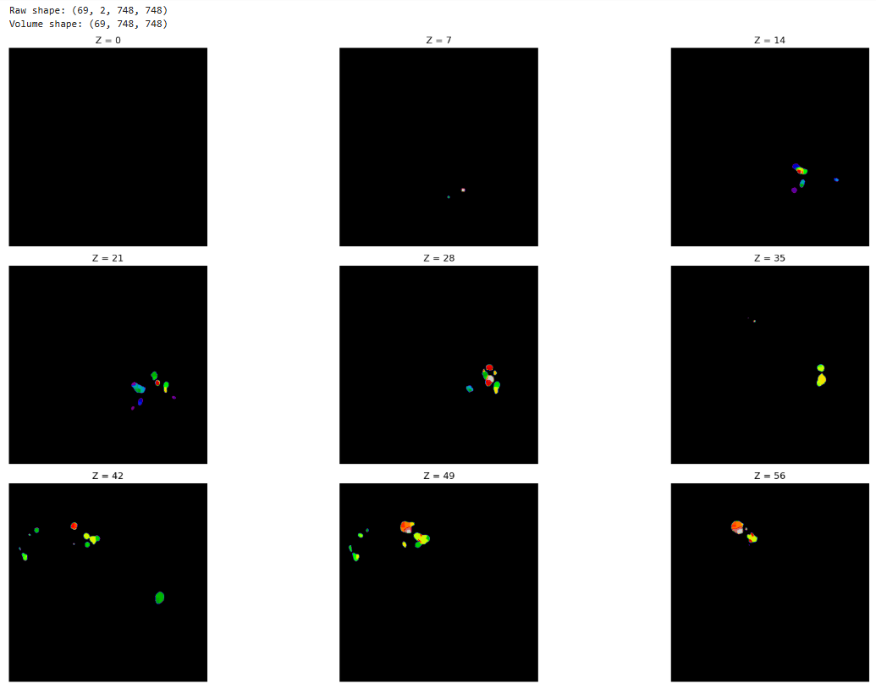
EXAMPLE

Slide 14
Questions?

